Slide 1
Secure Data Hiding in Image Using Steganography
CAPSTONE PROJECT
Presented By: GUDUR LUQMAN AFTAB
Student Name : Gudur Luqman Aftab
College Name & Department: SV College of Engineering, Dept of Computer Science and Engineering.
1
Gudur Luqman Aftab

Slide 2
OUTLINE
Problem Statement
Technology used
Implementation
Wow factor
End users
Result
Conclusion
GitHub Link
Future scope
2
Gudur Luqman Aftab

Slide 3
Problem Statement
With the rise of digital communication, ensuring data security and privacy is crucial. Traditional encryption secures data but makes it obvious, potentially attracting unwanted attention. Steganography hides information within digital media, making the message undetectable. This project, Secure Data Hiding in Image Using Steganography, embeds encrypted messages in images using the Least Significant Bit (LSB) technique for covert communication. For example, a journalist in a high-surveillance region can discreetly share sensitive information by hiding it within an innocent-looking image, ensuring secure transmission.
3
Gudur Luqman Aftab

Slide 4
Technology used
Operating System: Windows
IDE: Visual Studio Code
Programming Language: Python
Libraries & Packages Used:
NumPy: For handling image data as arrays.
OpenCV: For image processing and manipulation.
OS: For file handling and directory operations.
PyCryptodome (AES): For encrypting and decrypting hidden messages.
Base64 & Hashlib: For encoding and hashing operations.
Tkinter: Provides a GUI for file selection and user interaction.
4
Gudur Luqman Aftab

Slide 5
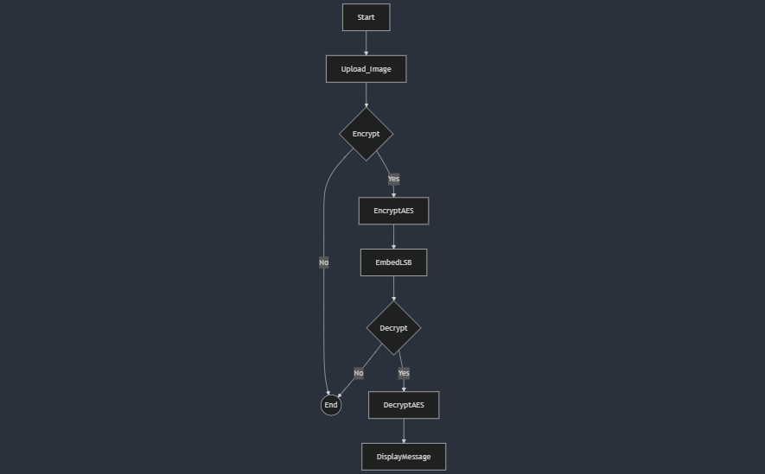
Flow Chart
5
Gudur Luqman Aftab

Slide 6
IMPLEMENTATION
Our approach to secure image steganography involves encryption and decryption techniques to ensure data confidentiality.
Encryption Strategy:
The secret message is encrypted using AES (CBC mode) with a password-derived key (SHA-256 hash).
A random IV (Initialization Vector) is generated for each encryption to enhance security.
The message is padded to match AES block size before encryption.
The encrypted message, along with the IV and a header containing its length, is converted to a binary format for embedding into the image using Least Significant Bit (LSB) steganography.
Decryption Strategy:
The hidden binary data is extracted from the image and reconstructed into the header, IV, and ciphertext.
The extracted ciphertext is decrypted using AES (CBC mode) with the same password-derived key.
The message is unpadded and converted back to text, ensuring secure retrieval.
This strategy ensures that even if the image is intercepted, the hidden message remains protected without the correct decryption key.
6
Gudur Luqman Aftab

Slide 7
Wow factors
Dual-Layer Security: The combination of AES encryption and LSB steganography ensures a high level of security. Even if someone suspects hidden data, the AES encryption prevents unauthorized access.
Undetectable Communication: Unlike traditional encryption, which makes data visibly encrypted, this method hides data within an image, making it indistinguishable from a normal image. This is particularly useful in scenarios requiring covert communication.
Efficient and Lossless Data Hiding: The LSB technique allows seamless embedding without noticeable image distortion, ensuring the image quality remains intact while secretly storing data.
User-Friendly & Automated Processing: With a GUI-based file selection using Tkinter and automated encryption/decryption, users can securely hide and retrieve messages without deep technical expertise.
Robust Error Handling & Scalability: The system includes safeguards against incorrect password entry, excessive data size, and format compatibility issues, making it reliable and adaptable for larger data storage in images.
7
Gudur Luqman Aftab

Slide 8
End users
This project is useful for individuals and organizations that require secure and covert communication. Some key users include:
Journalists & Whistleblowers – Securely share sensitive information in high-surveillance environments.
Military & Intelligence Agencies – Conceal classified messages to avoid detection by adversaries.
Cybersecurity Enthusiasts – Experiment with cryptography and steganography for research and learning.
Law Enforcement & Investigators – Exchange confidential data without attracting attention.
General Users – Protect personal and financial information from cyber threats.
8
Gudur Luqman Aftab

Slide 9
Results
Our Secure Image Steganography successfully encrypts and hides text messages within images while ensuring confidentiality. The process consists of:
User uploads an image (e.g., luqman.jpg).
Secret message encryption with a user-defined password.
Steganographic embedding of the encrypted message into the image.
Generated encrypted image saved as Noman_encrypted.png.
Decryption process extracts and decrypts the hidden message using the correct password.
Example Execution:
Input message: "hello aftab"
Ciphertext length: 16 bytes
Extracted message: "hello aftab“
This ensures data integrity, security, and confidentiality in covert communication.
9
Gudur Luqman Aftab

Slide 10
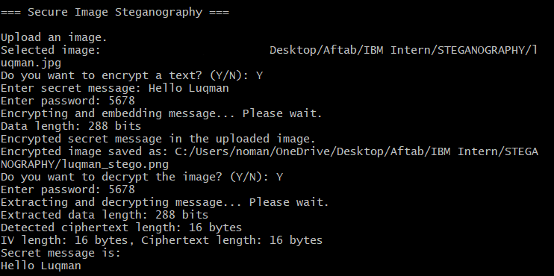
Results CONTD…
Fig. Screenshot of Steganography
10
Gudur Luqman Aftab

Slide 11
Conclusion
Our project addresses the growing need for secure and imperceptible data hiding in digital images by combining AES encryption with LSB-based steganography. Unlike traditional methods, which often compromise either security or image quality, our approach ensures strong encryption before embedding, making it resistant to unauthorized access. The uniqueness of our solution lies in its dual-layer protection, where even if the hidden data is extracted, it remains encrypted and unreadable without the correct decryption key. This makes it highly suitable for applications in secure communication, watermarking, and digital forensics.
11
Gudur Luqman Aftab

Slide 12
GitHub Link
https://github.com/LuqmanAftab/Secure-Data-Hiding-in-Image-Using-Steganography.git
E-mail id: luqmanaftabg6@gmail.com
12
Gudur Luqman Aftab

Slide 13
Future scope
The future of secure image steganography lies in enhancing security and efficiency through AI-driven optimization and quantum cryptography for unbreakable encryption. Expanding beyond static images, future systems may support video steganography for dynamic media concealment. Blockchain integration could ensure tamper-proof data verification, while improved algorithms will boost embedding capacity without compromising image quality. Additionally, real-time steganographic applications could emerge for secure communication in defense, journalism, and finance. As privacy concerns grow, these advancements will play a vital role in cybersecurity, digital forensics, and covert communication, ensuring robust and undetectable data hiding techniques.
13
Gudur Luqman Aftab

Slide 14
THANK YOU
14
Gudur Luqman Aftab

